Slide 1
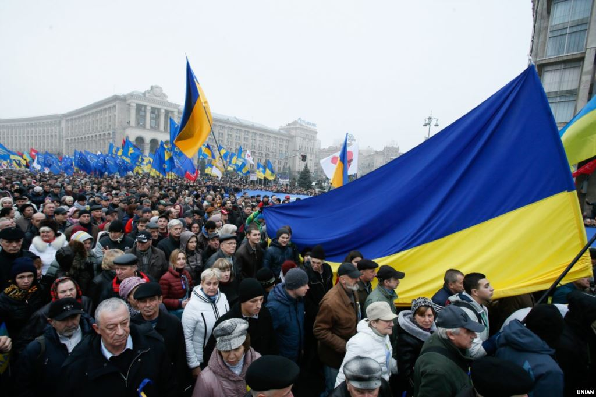
Current Events

Slide 2
POLITICS
Putin drops hints he might invade Ukraine to “protect Russian citizens” that may be living there
China likely to side with Russian in event of conflict
Obama approves $1B aid package to Ukraine and calls out Putin with “I don’t think that’s fooling anybody”
Syria has relinquished 1/3 of chemical weapons
United Nations human rights investigators believe world powers are responsible for failing to stop Syrian war crimes

Slide 3
BUSINESS & ENTERPRISE
Stocks very bull within this past week (beginning of March)
Fannie Mae, Freddie Mac both grew over 50% in past 2 weeks to over $4 mark (was just over $1 last semester)
Facebook, Tesla experiencing steady, fast growth (both have grown >20% within past month)
Twitter stock drops despite beating quarter revenue goals
For unknown reasons many international bankers from JP Morgan are killing themselves this year (12 suicides/missing persons/suspicious deaths and counting)

Slide 4
TECHNOLOGY
GRUBHUB IPO COMING SOON (Note to self: spend less on grubhub to buy grubhub stock)
Bitcoin makes quick recovery after Mt. Gox shutdown
Radioshack announces plans to close 20% of stores
Apple expected to release IOS 7.1 within one week
Flipboard acquires news app Zite from CNN around $60M
LinkedIn makes biggest acquisition of a San Francisco job matching site Bright.com

Slide 5
WORD ON THE STREET
Wall street generally believes Ukrainian conflict will not negatively affect US stock market
Warren Buffett disses Bitcoin
Another Bitcoin trading site (Flexcoin) shuts down after major theft
Just now: 28 year old Autumn Radtke CEO a Bitcoin exchange firm FirstMeta commits apparent suicide
Crisis in Ukraine makes it a good time to buy low on Russian stocks
Fast growers to watch: Priceline, Fannie Mae, Freddie Mac

